Slide 1


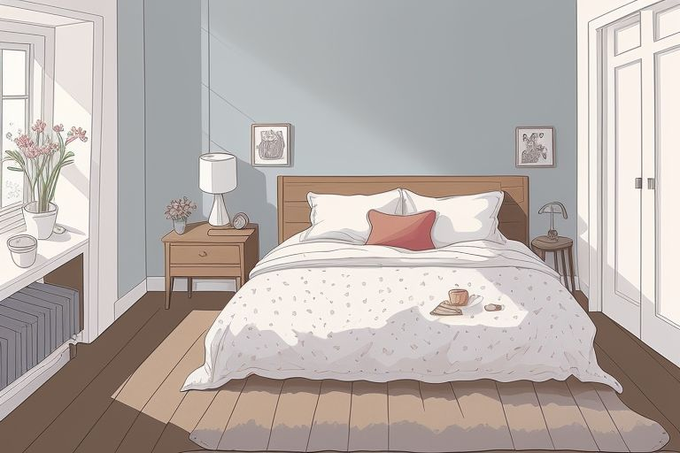

Slide 3


Slide 25
"What makes me happy?“
"What am I afraid of?"
"Who do I want to be?“
"Try something new."

